Slide 1

Telangana Growth Analysis
Stamp Registration, Transportation and Ts-Ipass

Slide 2
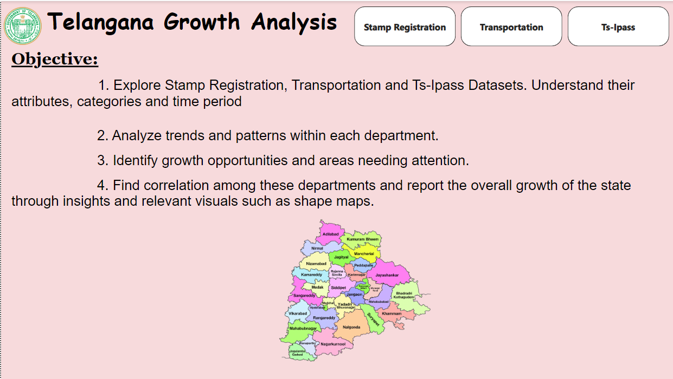
Introduction
Visual Insight Home Page

Slide 3
Stamp Registration
Stamp registration in Telangana, as in many other Indian states, is governed by the Indian Stamp Act, 1899. The primary purpose of stamp registration is to ensure the legality, authenticity, and enforceability of various documents, including property transactions, agreements, and other legal instruments. The Stamp and Registration Department of Telangana is responsible for administering stamp duties and registration processes in the state.
Process of Stamp Registration
1. Stamp Duty 2. Registration of Documents 3. Stamp Duty 4. Payment Registration Process 5. Online Registration 6. Post-Registration

Slide 4
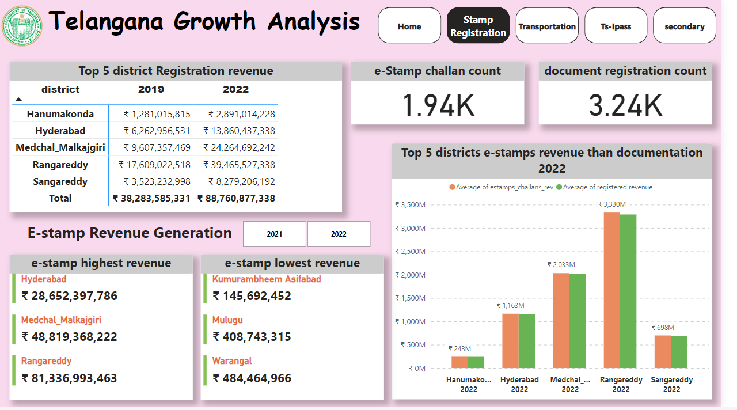
Stamp Registration

Slide 5
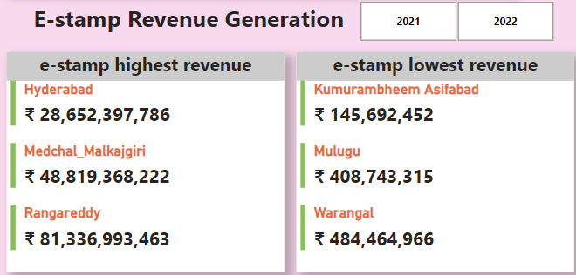
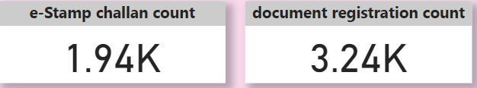
Top 5 District Compared With Highest and Lowest Revenue E-Stamp in Year 2021-2022
Telangana recorded stamp duty and collection charge collections of Rs 70 billion in eight months of FY 2022 (April-November) against Rs 52 billion during FY 2021. This also translated into an overall collection increase from 4 per cent in FY 2021 to 7 per cent in FY 2022.

Slide 6
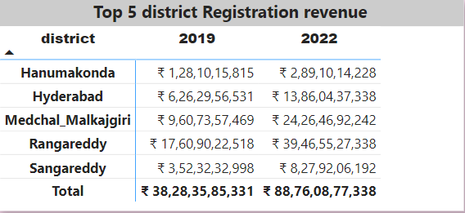
Revenue generated from document registration vary across districts in Telangana. and its Top 5 Districts
stamps duty and registration fees, and state excise duty are estimated to increase at an annual rate of 37% and 19% over 2019-20, respectively.and 108% change from 2020-21 RE to 2021-22 BE

Slide 7
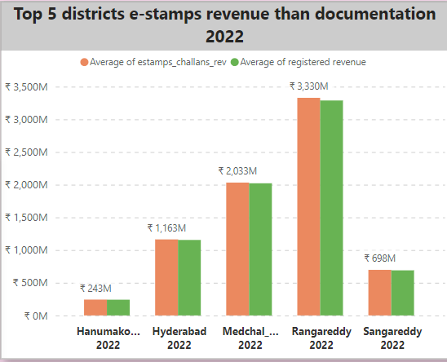
Top 5 districts where e-stamps revenue contributes significantly more to the revenue than the documents in FY 2022
The revision of market values of the lands and revision of stamp duty rates in 2021-22 (July-December) led to doubling of monthly revenue of stamps and registrations in comparison to the monthly revenue during the corresponding time period in 2019-20.

Slide 8
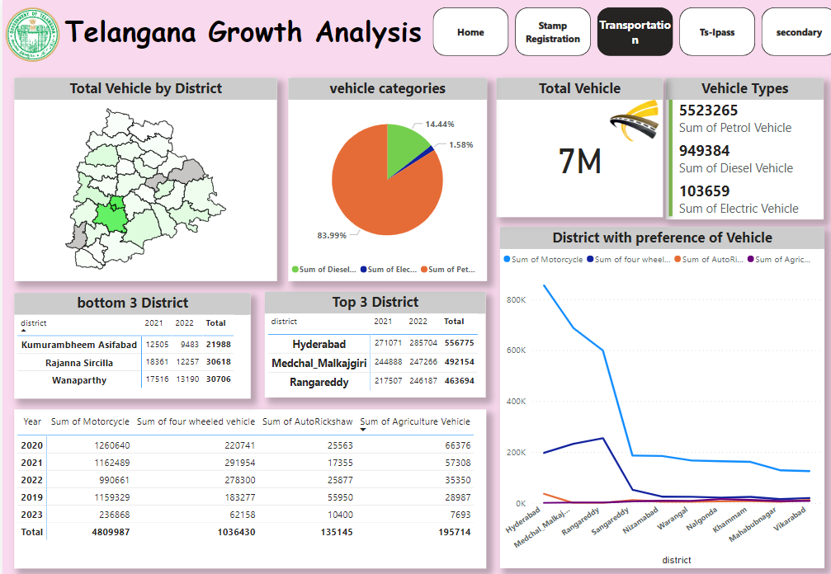
Transportation

Slide 9
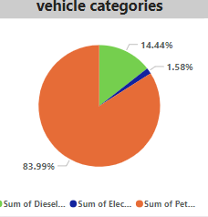
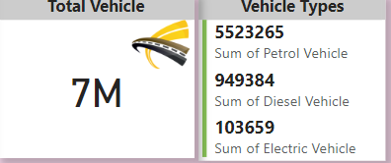
Are there any months or seasons that consistently show higher or lower sales rate, and if yes, what could be the driving factors?
Yes there is a higher purchase of vehicles during the month of march and October. This could be the tax reporting month for the new Year is April and generally monsson starts on October

Slide 10
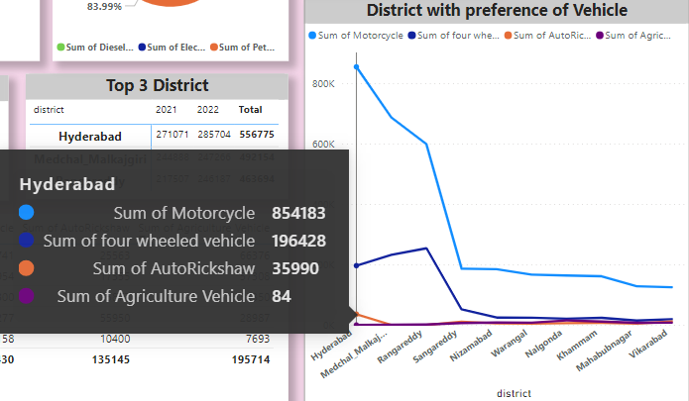
Are there any districts with a predominant preference for a specific vehicle class?
The number of people using motorcycles and motor cars are higher in the districts of Rangareddy, Medchal Malkajgiri and hyderabad as compared to the others. In hyderabad alone the count of motor cycles for the Year 2022 have crossed 2 lakhs.

Slide 11
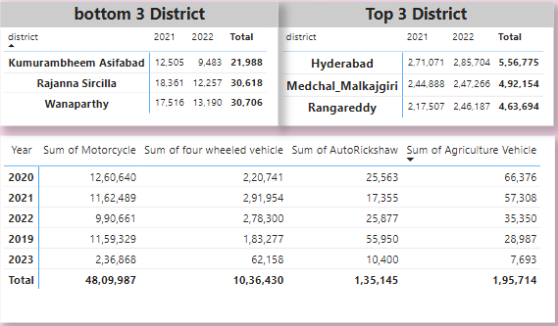
List down the top 3 and bottom 3 districts that have shown the highest and lowest vehicle sales growth during FY 2022
In District Kumurambheem Asifabad is the lowest Vehicle Sale compare to Year 2021 and 2022 and There is Increase in Vehicle sale in Year 2022

Slide 12
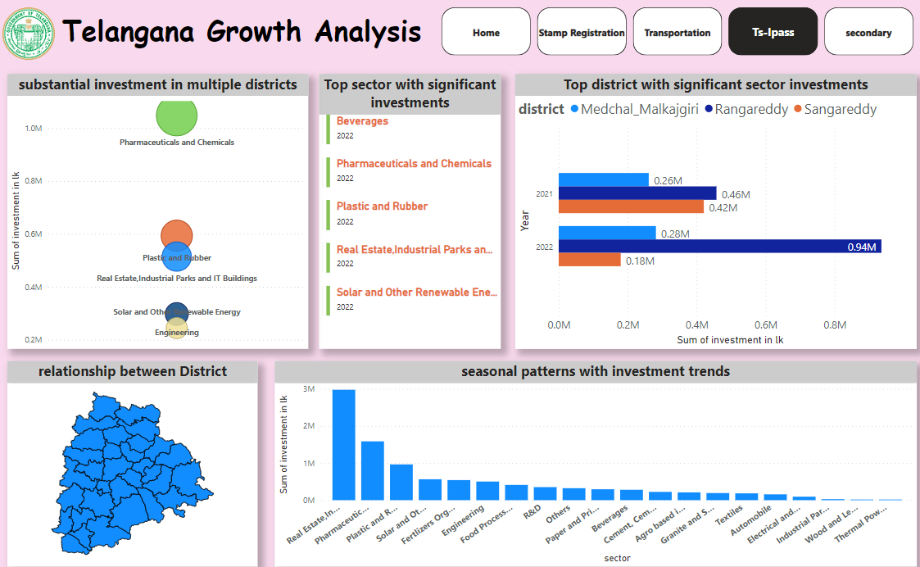
Telangana State Industrial Project Approval and Self-Certification System Ts-ipass

Slide 13
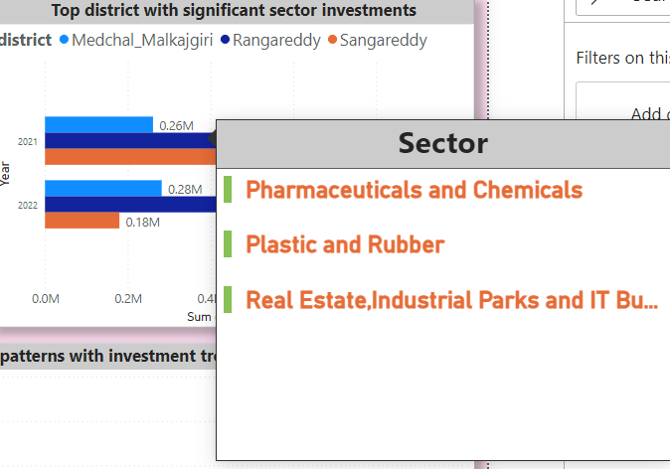
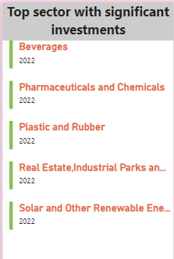
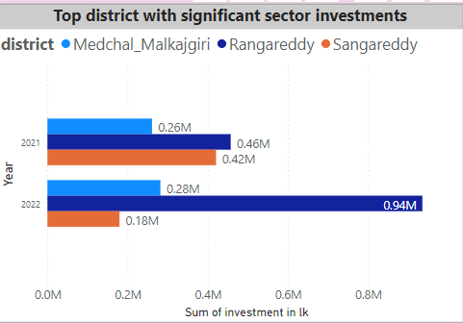
List down the top 5 sectors that have witnessed the most significant investments in FY 2022.
Beverages, Plastic and Rubber, Pharmaceuticals and Chemicals, Real Estate,Industrial Parks and IT Buildings, Solar and Other Renewable Energy, Engineering have witnessed the most significant investments Year 2022.
List down the top 3 districts that have attracted the most significant
sector investments during FY 2019 to 2022?
Rangareddy, Sangareddy and Medchal Malkajgiri have the most significant sector investments during Year 2019 to 2022. all the districts have a high correlation of sales of vehicles and stamps revenue to their total investments.

Slide 14
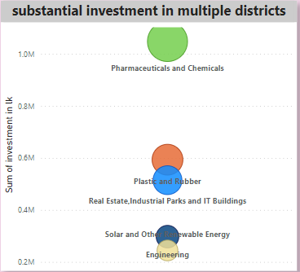
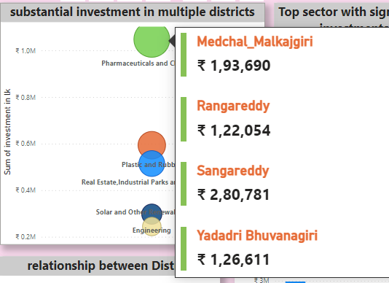
Are there any particular sectors that have shown substantial investment in multiple districts between FY 2021 and 20222?
Pharmaceuticals and Chemicals, and Plastic and Rubber sector show a substantial investment in multiple districts between Year 2021 and 2022

Slide 15
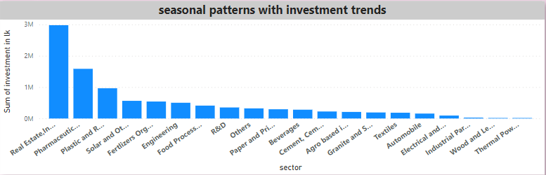
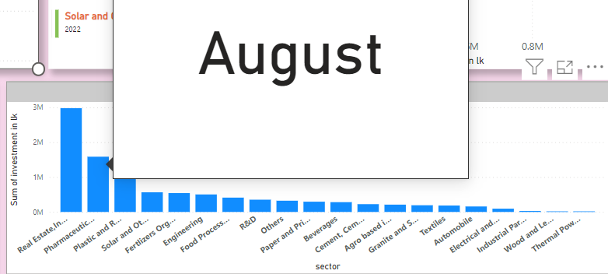
Can we identify any seasonal patterns or cyclicality in the investment trends for specific sectors?
Most of Investment is between April and August Fiscal Quarter 2 & 3. The Sector Like Real Estate,Industrial Parks and IT Buildings, Plastic and Rubber, Pharmaceuticals and Chemicals experience higher investments during particular months

Slide 16
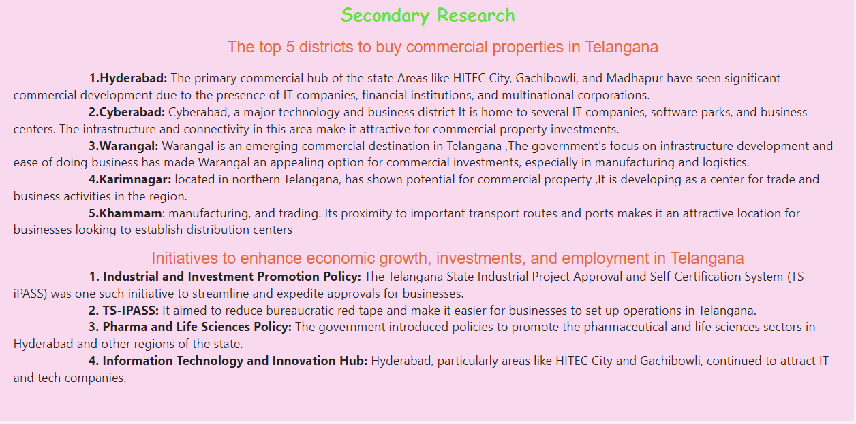
Secondary Research

Slide 17
Thank You

